Slide 3
Why are reporting guidelines important?
A reporting guideline is a simple, structured tool for health researchers to use while writing manuscripts. A reporting guideline provides a minimum list of information needed to ensure a manuscript can be, for example:
• Understood by a reader,
• Replicated by a researcher,
• Used by a doctor to make a clinical decision, and
• Included in a systematic review.
Reporting guidelines are more than just some thoughts about what needs to be in an academic paper. We define a reporting guideline as:
“A checklist, flow diagram, or structured text to guide authors in reporting a specific type of research, developed using explicit methodology.”

Slide 4
Why are reporting guidelines important?
All research articles should be written in accordance with the relevant research reporting guideline, this will ensure that you provide enough information for editors, peer reviewers and readers to understand how the research was performed and to judge whether the findings are likely to be reliable.

Slide 5
Reporting guidelines for main study types
Randomised trials | CONSORT Extensions
Observational studies | STROBE Cohort, case-control, cross sectional
Systematic reviews | PRISMA Meta-analysis of Observational Studies in Epidemiology (MOOSE)
Study protocols | SPIRIT PRISMA-P
Diagnostic/prognostic studies | STARD TRIPOD
Case reports | CARE Extensions
Clinical practice guidelines | AGREE RIGHT
Qualitative research | SRQR COREQ
Animal pre-clinical studies | ARRIVE
Quality improvement studies | SQUIRE Extensions
Economic evaluations | CHEERS Extensions
STARD checklist

Slide 7
Strengthening the Reporting of Observational studies in Epidemiology (STROBE) guidelines
Hossein Akbari
Assistant professor of epidemiology
Faculty of Health
TUOMS

Slide 8
Introducing STROBE
Strengthening the Reporting of Observational studies in Epidemiology (STROBE) guidelines
Cross sectional
Case control
Cohort
STROBE guidelines were developed following a collaborative initiative of epidemiologists, methodologists, statisticians, researchers, and journal editors in 2004.

Slide 9
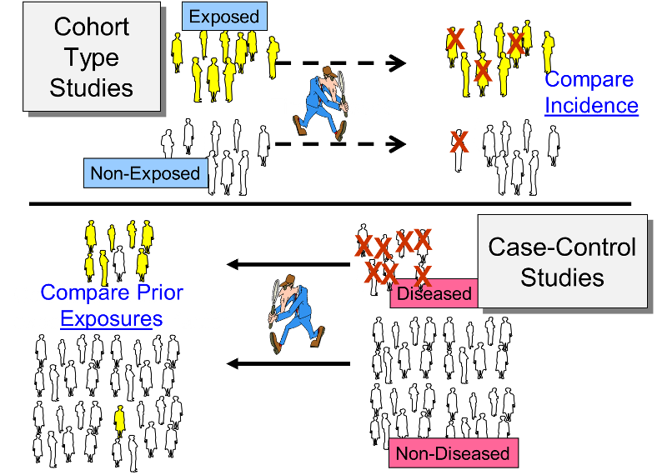
Observational studies

Slide 10
STROBE
The aim of the STROBE guidelines was to provide a readily available checklist to ensure a clear presentation of what was planned and conducted in an observational study.
Not to provide a methodological framework for conducting an observational study.
This is not an instrument for quality evaluation of observational research.

Slide 11
STROBE Checklist
A total of 22 checklist items contribute to the STROBE guidelines.
18 items are common to all the three observational designs, that is, cohort, cross‑sectional, and case–control studies.
The remaining four checklist items (items number 6, 12, 14, and 15) have specific variations according to the study design.

Slide 12
Item 1: Title and Abstract
The adopted study design should be part of the manuscript title to ensure correct indexing of the manuscript in electronic databases and visibility of a researcher’s work and increase the citation potential of the published manuscript.
The abstract should include a brief summary of the study and present only information found within the actual body of the manuscript.

Slide 13
Items 2 and 3: Introduction
The introduction should consist of background information that will set the scene for the study and the objective of the study.
The objective states the researcher’s intentions for conducting the study and potential hypotheses that may arise from such work.

Slide 14
Items 4–12: Methods
The methods section should provide a clear description of the study design at an early stage.
This will enable the reader to understand the basis of the study and be able to critically appraise the study’s methodology.
The STROBE guidelines do not allow the use of the words “prospective” or “retrospective” or “concurrent” or “historical,” but rather encourage the researcher to describe the actual methodology!

Slide 15
STROBE (Methods section)

Slide 16
STROBE (Methods section)

Slide 17
Items 13–17: Results
The results section should give an in‑depth account of the response rate and the description of the study population along with the main descriptive and analytical results.
The information provided will depend on the type of observational design (i.e., cohort, case–control, or cross‑sectional) followed by the researcher and the corresponding statistical analysis performed.

Slide 18
STROBE (Results section)

Slide 19
Items 18–21: Discussion
Item 22: Funding and Sponsorship

Slide 20
Standards for Reporting of Diagnostic Accuracy
(STARD)
Improve the accuracy and completeness of research reporting and allow readers to assess the “potential for bias” in the study reported.
Complete and accurate reporting allows the reader to detect the potential for bias in the study (internal validity) and to assess the generalizability and applicability of the results (external validity).
Always use:
FLOW CHART or Diagram
CHECKLIST

Slide 21
Diagnostic accuracy can be expressed in many ways, including:
Sensitivity and specificity
likelihood ratios
Predictive Values (positive/negative)
Area under a receiver operator characteristic (ROC) curve.

Slide 22
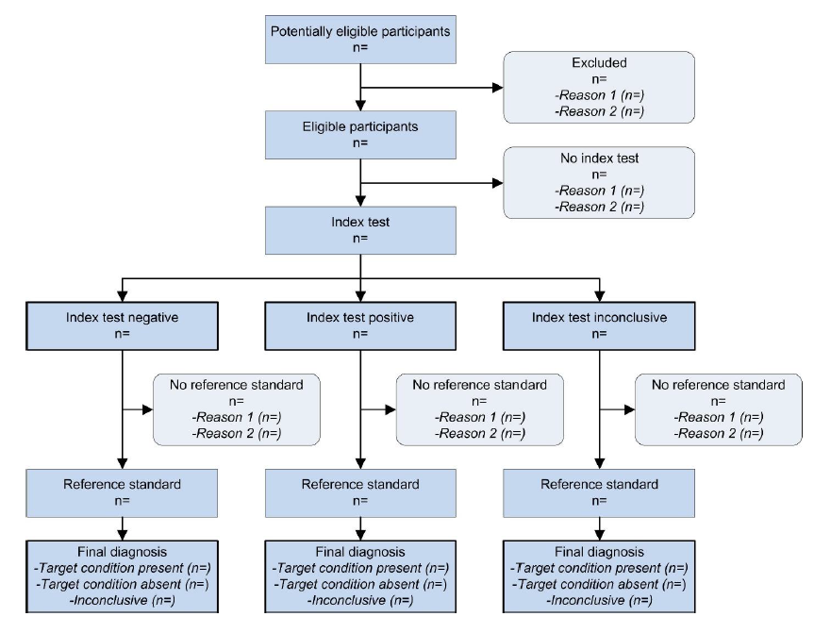
FLOW CHART or Diagram

Slide 23
STARD checklist
This STARD list was released in 2015. The 30 items were identified by an international expert group of methodologists, researchers, and editors. The guiding principle in the development of STARD was to select items that, when reported, would help readers to judge the potential for bias in the study, to appraise the applicability of the study findings and the validity of conclusions and recommendations. The list represents an update of the first version, which was published in 2003.

Slide 24
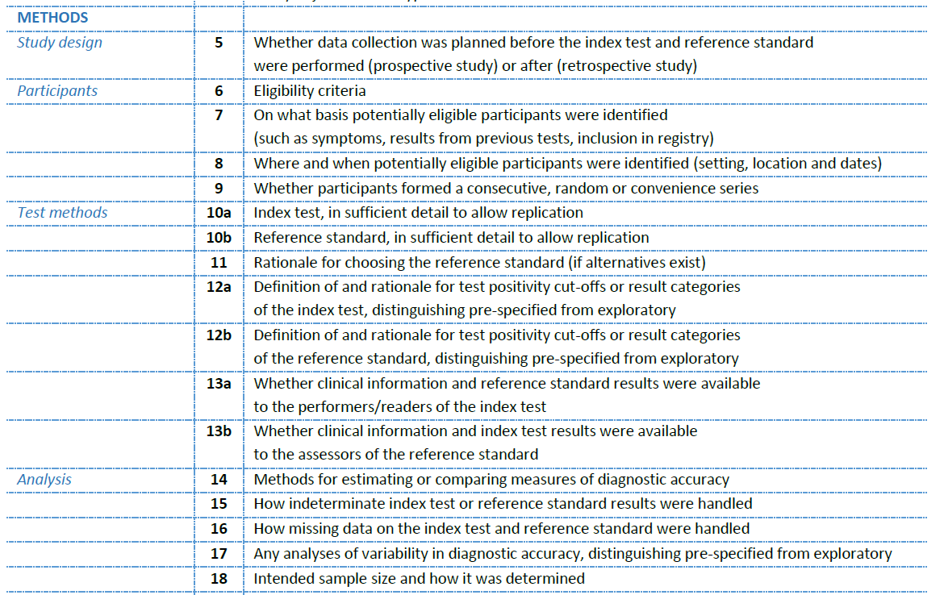

Slide 27
Reporting Guidelines for Qualitative Research
Prof. Hamid Allahverdipour
Tabriz University of Medical Sciences
Editor-in-Chief of Health Promotion Perspectives

Slide 28
Guidelines on reporting qualitative research
The three widely used Guidelines on reporting qualitative research
the COREQ (Consolidated criteria for Reporting Qualitative research)
the SRQR (Standards for Reporting Qualitative Research)
the ENTREQ (Enhancing Transparency in Reporting the synthesis of Qualitative research).

Slide 29
COREQ checklist (Consolidated criteria for Reporting Qualitative research)

Slide 30
COREQ checklist
The COREQ checklist was developed to improve the reporting quality of qualitative studies using interviews and focus groups (Tong et al., 2007).
It consists of 32 items grouped into three domains:
Research team and reflexivity
- Study design
Data analysis and reporting.

Slide 31
COREQ checklist
1. Research team & reflexivity
Personal characteristics of the researchers who conducted the interviews?
Their credentials, occupation, gender, experience & training?
These can all impact the quality and type of data collected
Relationship of researchers with participants
Interviewer characteristics

Slide 32
Domain 1: Research team and reflexivity
Topic | Item No. | Guide Questions/Description | Reported on Page No
Personal characteristics
Interviewer/facilitator | 1
Credentials | 2 | What were the researcher’s credentials? E.g. PhD, MD
Occupation | 3 | What was their occupation at the time of the study?
Gender | 4 | Was the researcher male or female?
Experience and training | 5
Relationship with participants
Relationship established | 6 | Was a relationship established prior to study commencement?
Participant knowledge of the interviewer | 7 | What did the participants know about the researcher? e.g. personal goals, reasons for doing the research
Interviewer characteristics | 8 | What characteristics were reported about the inter viewer/facilitator? e.g. Bias, assumptions, reasons and interests in the research topic

Slide 33
COREQ checklist
2. Study design
Theoretical framework
Participant selection
Sampling –how were participants selected
Method of approach
Sample size
Non-participation
Setting
Setting of data collection
Presence of non-participants
Description of sample

Slide 34
COREQ checklist
2. Study design cont…
Data collection
Interview guides
Repeat interviews
Audio/visual recording
Field notes
Duration
Data saturation
Transcripts returned

Slide 35
Domain 2: Study design
Topic | Item No. | Guide Questions/Description | Reported on Page No
Theoretical framework
Methodological orientation and Theory | 9 | What methodological orientation was stated to underpin the study? e.g. grounded theory, discourse analysis, ethnography, phenomenology, content analysis
Participant selection
Sampling | 10 | How were participants selected? e.g. purposive, convenience, consecutive, snowball
Method of approach | 11 | How were participants approached? e.g. face-to-face, telephone, mail, email
Sample size | 12 | How many participants were in the study?
Non-participation | 13 | How many people refused to participate or dropped out? Reasons?

Slide 36
Domain 2: Study design
Topic | Item No. | Guide Questions/Description | Reported on Page No
Setting
Setting of data collection | 14 | Where was the data collected? e.g. home, clinic, workplace
Presence of nonparticipants | 15 | Was anyone else present besides the participants and researchers?
Description of sample | 16 | What are the important characteristics of the sample? e.g. demographic data, date

Slide 37
Domain 2: Study design
Topic | Item No. | Guide Questions/Description | Reported on Page No
Setting
Setting of data collection | 14 | Where was the data collected? e.g. home, clinic, workplace
Presence of nonparticipants | 15 | Was anyone else present besides the participants and researchers?
Description of sample | 16 | What are the important characteristics of the sample? e.g. demographic data, date

Slide 38
Domain 2: Study design
Topic | Item No. | Guide Questions/Description | Reported on Page No
Data collection
Interview guide | 17 | Were questions, prompts, guides provided by the authors? Was it pilot tested?
Repeat interviews | 18 | Were repeat inter views carried out? If yes, how many?
Audio/visual recording | 19 | Did the research use audio or visual recording to collect the data?
Field notes | 20 | Were field notes made during and/or after the inter view or focus group?
Duration | 21 | What was the duration of the inter views or focus group?
Data saturation | 22 | Was data saturation discussed?
Transcripts returned | 23 | Were transcripts returned to participants for comment and/or correction?

Slide 39
COREQ checklist
3. Analysis & findings
Data analysis
Number of data coders
Description of the coding tree
Derivation of themes (inductive or deductive)
Software
Participant checking
Reporting
Quotations presented
Data & findings consistent
Clarity of major & minor themes

Slide 40
Domain 3: analysis and findings
Topic | Item No. | Guide Questions/Description | Reported on Page No
Data analysis
Number of data coders | 24 | How many data coders coded the data?
Description of the coding tree | 25 | Did authors provide a description of the coding tree?
Derivation of themes | 26 | Were themes identified in advance or derived from the data?
Software | 27 | What software, if applicable, was used to manage the data?
Participant checking | 28 | Did participants provide feedback on the findings?

Slide 41
Domain 3: analysis and findings
Topic | Item No. | Guide Questions/Description | Reported on Page No
Reporting
Quotations presented | 29 | Were participant quotations presented to illustrate the themes/findings? Was each quotation identified? e.g. participant number
Data and findings consistent | 30 | Was there consistency between the data presented and the findings?
Clarity of major themes | 31 | Were major themes clearly presented in the findings?
Clarity of minor themes | 32 | Is there a description of diverse cases or discussion of minor themes?

Slide 42
COREQ checklist
While the uptake of COREQ has been modest, its publication has led to improved reporting quality in primary qualitative studies (de Jong et al., 2021).
However, the credibility of COREQ has been questioned, as attempts to replicate its development process revealed issues with coding trustworthiness and decontextualization of original checklist items (Buus & Perron, 2019).
Despite these concerns, COREQ remains widely endorsed by scholarly journals for evaluating qualitative research (Buus & Perron, 2019).

Slide 43
SRQR checklist The Standards for Reporting Qualitative Research

Slide 44
SRQR checklist
The Standards for Reporting Qualitative Research (SRQR) checklist is a 21-item tool used to evaluate the quality of qualitative research reporting (O'Brien et al., 2014).
It addresses various aspects of research, including context, data collection methods, and analysis.
The SRQR evolved from earlier guidelines like QUOROM, which was later replaced by PRISMA for systematic reviews and meta-analyses

Slide 45
Title and abstract
Title - Concise description of the nature and topic of the study Identifying the study as qualitative or indicating the approach (e.g., ethnography, grounded theory) or data collection methods (e.g., interview, focus group) is recommended
Abstract - Summary of key elements of the study using the abstract format of the intended publication; typically includes background, purpose, methods, results, and conclusions

Slide 46
Introduction
Problem formulation - Description and significance of the problem/phenomenon studied; review of relevant theory and empirical work; problem statement
Purpose or research question - Purpose of the study and specific objectives or questions

Slide 47
Methods
Qualitative approach and research paradigm - Qualitative approach (e.g., ethnography, grounded theory, case study, phenomenology, narrative research) and guiding theory if appropriate; identifying the research paradigm (e.g., postpositivist, constructivist/ interpretivist) is also recommended.
Researcher characteristics and reflexivity - Researchers’ characteristics that may influence the research, including personal attributes, qualifications/experience, relationship with participants, assumptions, and/or presuppositions; potential or actual interaction between researchers’ characteristics and the research questions, approach, methods, results, and/or transferability
Notes:
**The rationale should briefly discuss the justification for choosing that theory, approach, method, or technique rather than other options available, the assumptions and limitations implicit in those choices, and how those choices influence study conclusions and transferability. As appropriate, the rationale for several items might be discussed together.

Slide 48
Methods
Context - Setting/site and salient contextual factor.
Sampling strategy - How and why research participants, documents, or events were selected; criteria for deciding when no further sampling was necessary (e.g., sampling saturation).
Ethical issues pertaining to human subjects - Documentation of approval by an appropriate ethics review board and participant consent, or explanation for lack thereof; other confidentiality and data security issues.

Slide 49
Methods
Data collection methods - Types of data collected; details of data collection procedures including (as appropriate) start and stop dates of data collection and analysis, iterative process, triangulation of sources/methods, and modification of procedures in response to evolving study findings.
Data collection instruments and technologies - Description of instruments (e.g., interview guides, questionnaires) and devices (e.g., audio recorders) used for data collection; if/how the instrument(s) changed over the course of the study

Slide 50
Methods
Units of study - Number and relevant characteristics of participants, documents, or events included in the study; level of participation (could be reported in results).
Data processing - Methods for processing data prior to and during analysis, including transcription, data entry, data management and security, verification of data integrity, data coding, and anonymization/de-identification of excerpts.

Slide 51
Methods
Data analysis - Process by which inferences, themes, etc., were identified and developed, including the researchers involved in data analysis; usually references a specific paradigm or approach.
Techniques to enhance trustworthiness - Techniques to enhance trustworthiness and credibility of data analysis (e.g., member checking, audit trail, triangulation).

Slide 52
Results/findings
Synthesis and interpretation - Main findings (e.g., interpretations, inferences, and themes); might include development of a theory or model, or integration with prior research or theory.
Links to empirical data - Evidence (e.g., quotes, field notes, text excerpts,
photographs) to substantiate analytic findings.

Slide 53
Discussion
Integration with prior work, implications, transferability, and contribution(s) to the field - Short summary of main findings; explanation of how findings and conclusions connect to, support, elaborate on, or challenge conclusions of earlier scholarship; discussion of scope of application/generalizability; identification of unique contribution(s) to scholarship in a discipline or field.
Limitations - Trustworthiness and limitations of findings

Slide 54
Other
Conflicts of interest - Potential sources of influence or perceived influence on study conduct and conclusions; how these were managed.
Funding - Sources of funding and other support; role of funders in data collection, interpretation, and reporting.

Slide 55
Dr. Sina Ghertasi Oskouei, DDS Tabriz University of Medical Sciences Associate Editors of Journal of Advanced Periodontology and Implant Dentistry

Slide 56
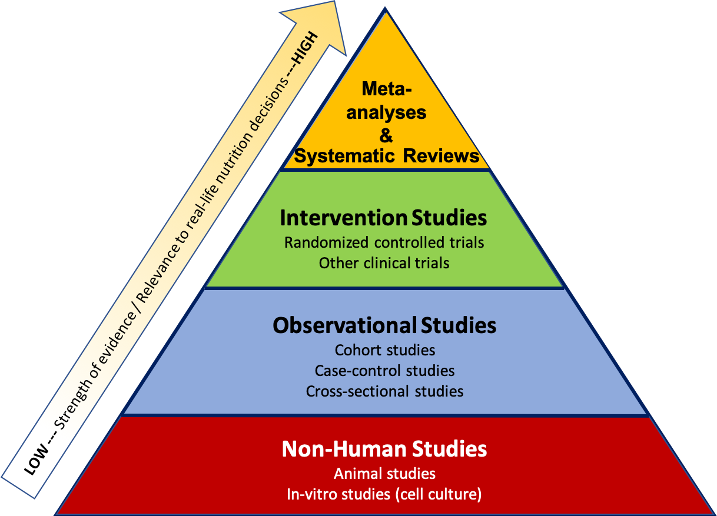
Source: https://openoregon.pressbooks.pub/nutritionscience/chapter/2b-types-of-research-studies/

Slide 57
Types of reviews
Reviews
(narrative/literature/
traditional)
Systematic reviews
Meta-analysis

Slide 58
Bias
Bias means something that will cause a consistent deviation from the truth.
This is different from the play of chance.

Slide 59
Source of bias
There are three possible sources of bias in reviews:
bias arising from the studies included in the review
bias arising from the studies not included in the review
Bias arising from the way the review is done.

Slide 60
Systematic review
Comprehensively
locates
evaluates
synthesizes
all the available literature on a given topic
using a strict scientific design which
must itself be reported in the review

Slide 61
PRISMA (Preferred Reporting Items of Systematic reviews and Meta-Analyses) Guidelines
The main PRISMA reporting guideline (the PRISMA 2020 statement) primarily provides guidance for the reporting of systematic reviews evaluating the effects of interventions. PRISMA 2020 is complemented by various PRISMA extensions, which provide guidance for the reporting of different types or aspects of systematic reviews and other types of evidence synthesis (e.g. scoping reviews).
Key documents:
PRISMA 2020 checklist
PRISMA 2020 flow diagram
PRISMA 2020 statement paper
PRISMA 2020 Explanation and Elaboration paper
https://www.prisma-statement.org/

Slide 62
Title, Abstract, Introduction

Slide 64
Results

Slide 65
Discussion and other information

Slide 67
A PRISMA Flow Diagram

Slide 68
CONSORT 2010 Consolidated Standards of Reporting Trails

Slide 73
TUOMS PRESS

